Slide 1
JARVIS
INTRODUCING
AI-powered voice assistant

Slide 2

Introduction to Jarvis Your Personal Voice Assistant
Jarvis is an AI-powered voice assistant designed to recognize voice commands, process them, and execute various tasks efficiently. Inspired by virtual assistants like Google Assistant and Apple's Siri, Jarvis helps users perform actions through voice commands, making interactions more intuitive and accessible.
Firebase Database
Artificial intelligence (AI)
JARVIS
Machine learning (ML)
Voice command automation

Slide 3
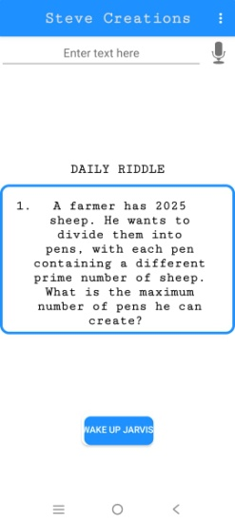



Artificial intelligence (AI)
Request
Response
> AI-Powered Assistance via Gemini API
> Gemini AI API calling

Slide 4
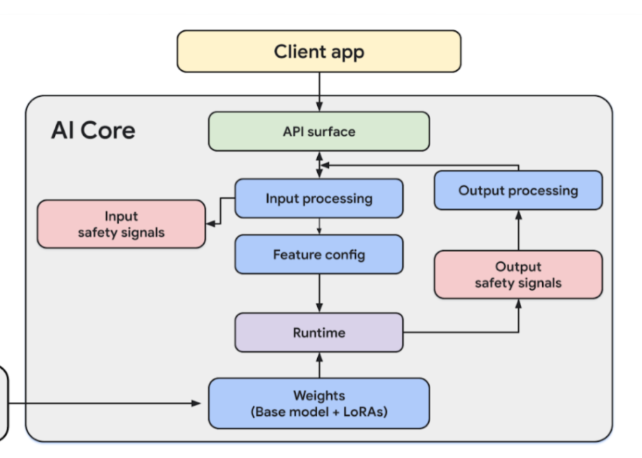
AI Core model diagram

Slide 5
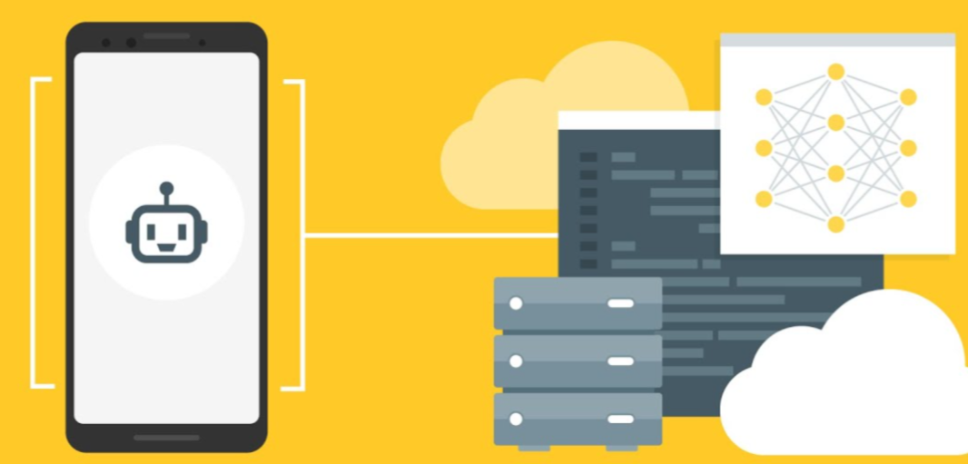

Machine learning (ML)

Slide 6
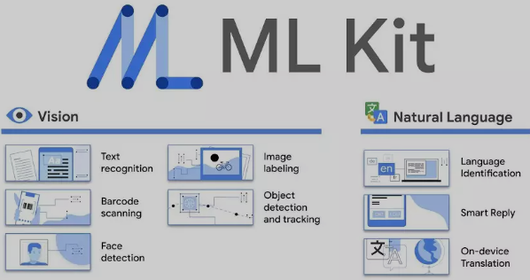
-> Using natural language model

Slide 7

-> Firebase realtime database service
Users create an account – get user informations
User interactive with jarvis – jarvis called user name and user informations
Users can login any other android device - user details saved on firebase

Slide 8
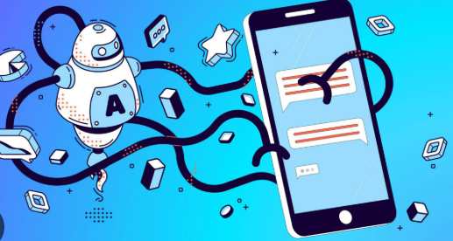

Voice command automation
This voice assistant app
can make calls, send texts,
and control music, even when the
phone’s screen is locked
or the app is closed.

Slide 9
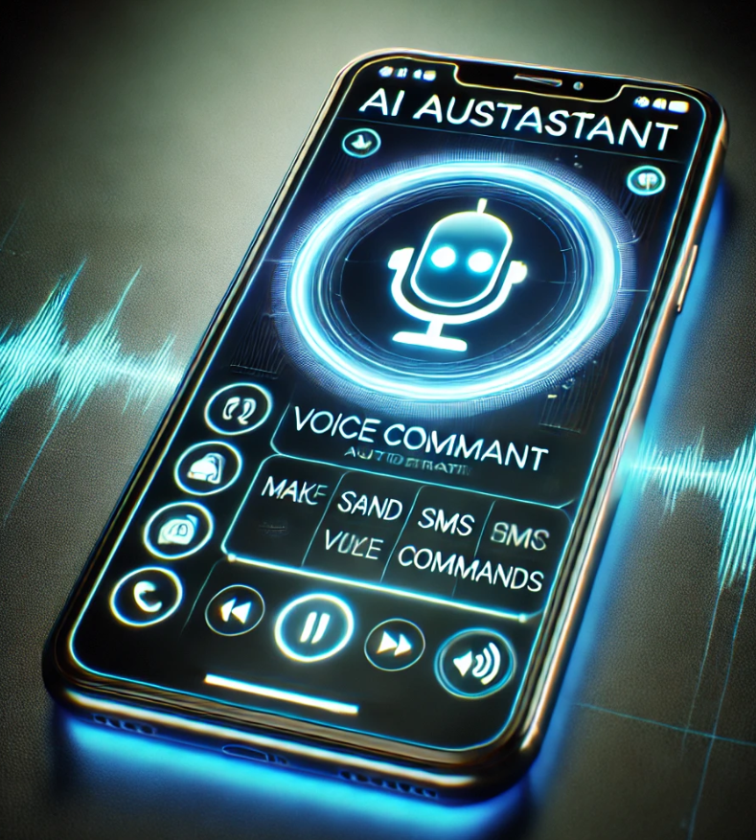
CALL TO Dialer name
Dialer name SMS Message
Play Music, Stop Music, Next Music, Previous Song
Life Saver
Deactivate Jarvis

Slide 10
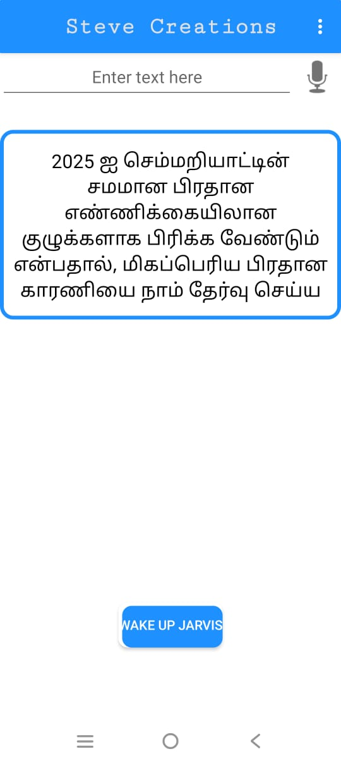
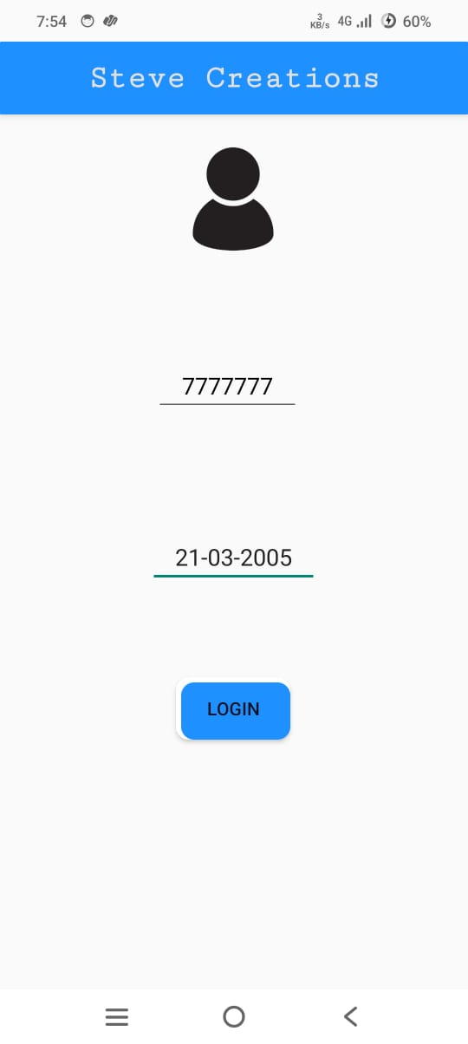
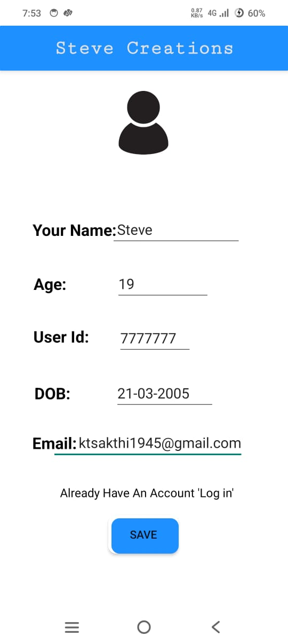
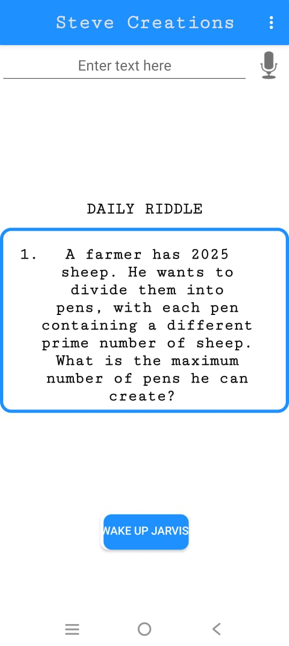
Jarvis UI
Sign Up
Home
Translate
Login

Slide 11
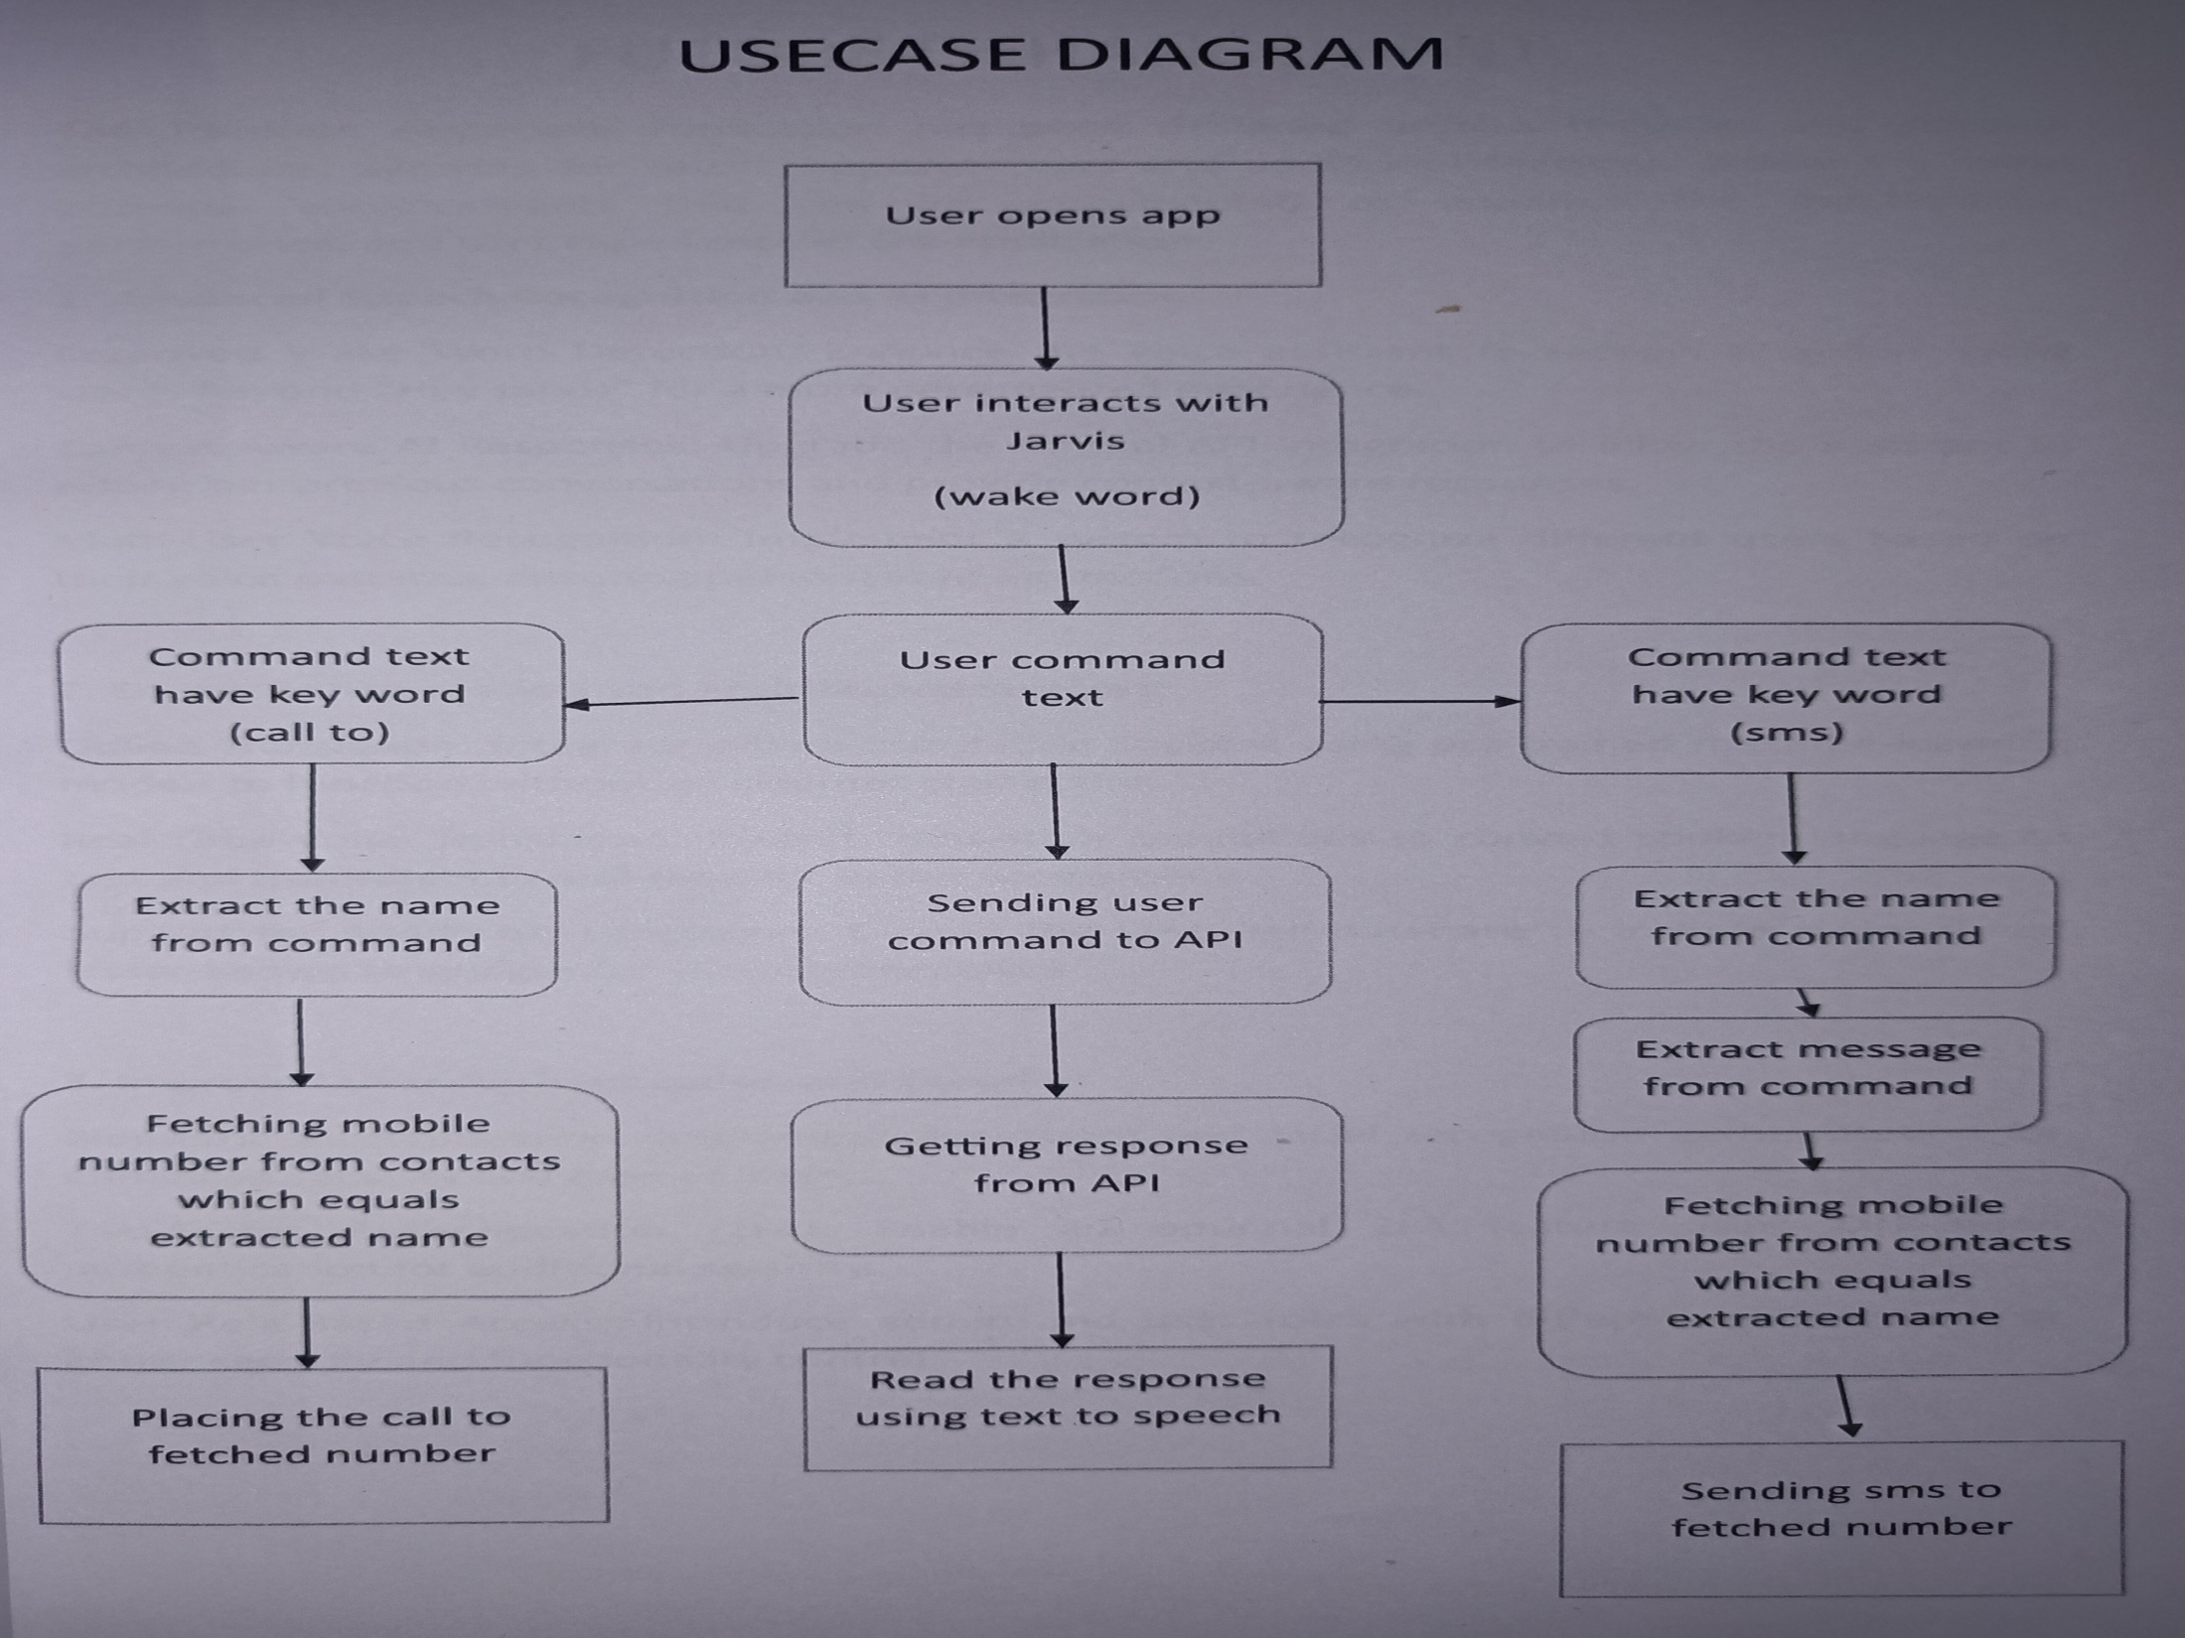

Slide 12


Slide 13
Thank You

